Slide 1
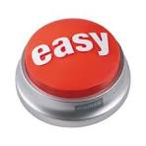

The Altrusa
“EASY” Button
Using AI To Share Our Story
Linda Ring (Central CT)
Service Committee Chair
2026 Altrusa District One Conference
Notes:
Before we get started.. Tell you a story.
Picture this:
It’s after a meeting, we’ve had a great meal, lots of ideas, good energy…
… someone says
“We should really post about this!”
<<<<<<< silence >>>>>>>>>
People start looking at their phones, gathering their things, making intense eye contact with the dessert table…
You all know what’s coming next…
“Who wants to do the post?”
Now – fast forward a few hours.
Someone – one of us – kind, dedicated, possibly slightly voluntold… sits down to write it.
And it starts like this…
Altrusa met today. It was nice. Thank you to everyone who came.
And you look at it and think, well THAT does not reflect the energy in that room…
Because what happened was – we connected, we laughed, we planned meaningful service, and maybe we stuffed a few bags or solved a community problem.
So you try again.
You rewrite it once or twice. And you think WHY IS THIS SO HARD?
This is when AI becomes your new BEST FRIEND!
AI doesn’t replace what we do…
It just helps us take all that ENERGY, HEART and IMPACT
And put it into words that make people stop scrolling and say…
OH, I WANT TO BE A PART OF THAT!
Today, we will take that STRUGGLE and turn it into something a whole lot easier… maybe even a little fun!

Slide 2
Why This Matters…
We do amazing work… but not everyone sees it
Strong visibility = stronger impact
More awareness ➔ more members, volunteers, sponsors
AI helps us communicate consistently and creatively
Notes:
We do amazing work… but not everyone sees it
Strong visibility = stronger impact
More awareness ➔ more members, volunteers, sponsors
AI helps us communicate consistently and creatively

Slide 3

What AI Can Do for US
Write social media posts in seconds
Generate newsletters and press releases
Generate event flyers and captions
Help brainstorm campaign ideas
Adapt tone: professional, warm, fun, persuasive
Notes:
Ai is like having a really enthusiastic intern that never sleeps!
Write social media posts in seconds
Generate newsletters and press releases
Generate event flyers and captions
Help brainstorm campaign ideas
Adapt tone: professional, warm, fun, persuasive

Slide 4

Benefits of Using AI
Saves time (no more staring at a blank page)
Improves writing quality
Keeps messaging clear and consistent
Sparks fresh ideas
Helps us reach a wider audience
Notes:
AI is not replacing anyone… just upgrading our first draft.
Saves time (no more staring at a blank page)
Improves writing quality
Keeps messaging clear and consistent
Sparks fresh ideas
Helps us reach a wider audience
It helps us get past the Blank Page Syndrome. – Gives us more time to do service projects!

Slide 5

Where We Can Use AI
Facebook & Instagram posts
Monthly Newsletters
Event promotions
Sponsorship requests
Thank-you messages
Website content
Notes:
Facebook & Instagram posts
Write an intro for our new member
Monthly Newsletters
Summarize meeting minutes
Event promotions
Create a flyer for our community food drive
Sponsorship requests
Write a sponsorship request letter to local banks for our upcoming conference.
Ask for items to give away and a donation toward getting an awesome guest speaker
Thank-you messages
Need a thank you message for new judge to our poetry contest
Website content

Slide 6
Example:
Before:
AFTER (AI-Assisted):
Join us for an afternoon of fellowship and fun as we come together to support our community!
Your participation helps us continue making a meaningful difference!
Join us for our event. It will be fun.
Notes:
Look at an example
Before:
Join us for our event. It will be fun.
AFTER (AI-Assisted):
Join us for an afternoon of fellowship and fun as we come together to support our community!
Your participation helps us continue making a meaningful difference!

Slide 7
Sample AI Prompts (Social Media)
Write a friendly Facebook post promoting an Altrusa community service project. Include a call to action and a warm tone.
Create a short engaging Instagram caption for a volunteer event. Add 5 relevant hashtags.
Write a post thanking volunteers for their time and dedication, with a touch of humor.
Notes:
Write a friendly Facebook post promoting an Altrusa community service project. Include a call to action and a warm tone.
Create a short engaging Instagram caption for a volunteer event. Add 5 relevant hashtags.
Write a post thanking volunteers for their time and dedication, with a touch of humor.

Slide 8
Sample AI Prompts (Events & Outreach)
Write a press release announcing an Altrusa fundraiser supporting LITERACY. Keep it professional and inspiring.
Create an email inviting community members to attend an upcoming service event. Keep it warm and welcoming.
Write a sponsorship request letter highlighting community impact and benefits to sponsors.
Notes:
Write a press release announcing an Altrusa fundraiser supporting LITERACY. Keep it professional and inspiring.
Create an email inviting community members to attend an upcoming service event. Keep it warm and welcoming.
Write a sponsorship request letter highlighting community impact and benefits to sponsors.

Slide 9
Sample AI Prompts (Newsletter)
Write a president’s message for an Altrusa newsletter highlighting recent events, thanking members and encouraging participation.
Summarize last month’s club activities in a friendly and engaging tone
Notes:
Write a president’s message for an Altrusa newsletter highlighting recent events, thanking members and encouraging participation.
Summarize last month’s club activities in a friendly and engaging tone
Use AI to summarize meeting minutes into “Member Highlights”

Slide 10
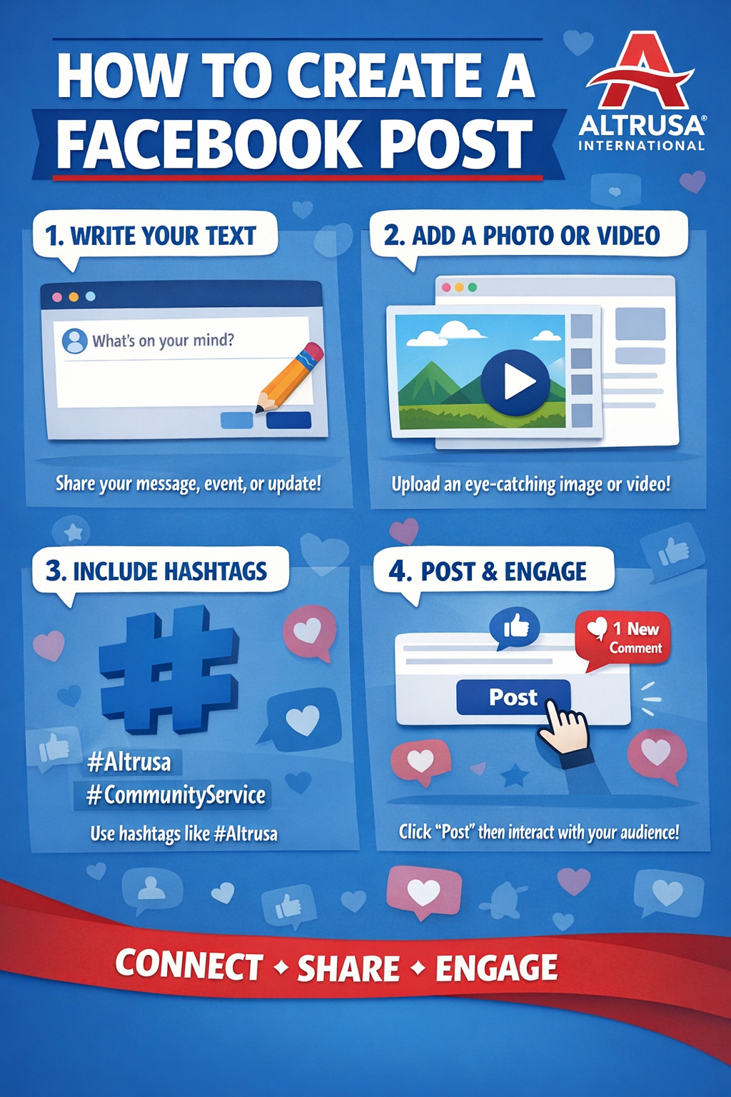
Create an image to include in a FB post, on how to create a FB post, include Altrusa logo

Slide 11
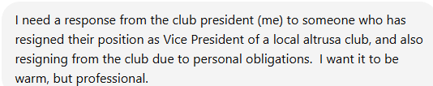
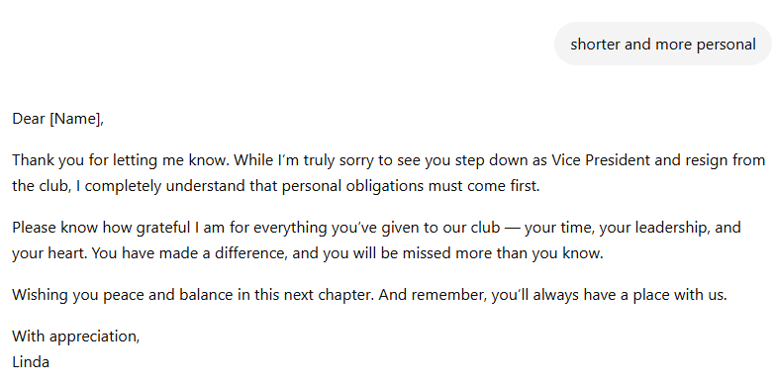

Slide 12
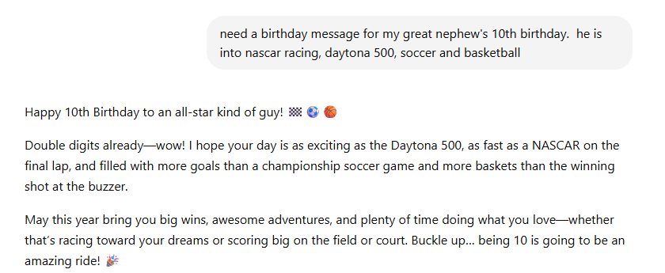

Slide 13
Template for Well-Rounded AI Output
Role
Who are you? What voice should be used?
Task
Create a post. Write an article. Create a flyer.
Details
Who, What, When, Where, Why
Extras
Include a CTA (Call To Action) and 3-5 Hashtags
Tone
Warm, Inviting and slightly upbeat
More professional
Notes:
Role
Who are you? What voice should be used?
Task
Create a post. Write an article. Create a flyer.
Details
Who, What, When, Where, Why
Tone
Warm, Inviting and slightly upbeat
More professional
Extras
Include a CTA (Call To Action) and 3-5 Hashtags

Slide 14
EXAMPLE:
Act as a communications coordinator for a community service organization.
Write a warm and inviting Facebook post promoting
an Altrusa book drive
on May 10
at the Public Library
to support local schools.
Include a Call to action and 5 hashtags.

Slide 15
Tips for Good Results
Be specific (details matter)
Ask for tone (funny, heartfelt, professional)
Request length (short, medium, detailed)
Revise and personalize before posting
Keep your club’s voice authentic
Notes:
Be specific (details matter)
Ask for tone (funny, heartfelt, professional)
Request length (short, medium, detailed)
Revise and personalize before posting
Keep your club’s voice authentic

Slide 16
Keep it HUMAN
AI is a tool – not a replacement
Always review before publishing
Add personal touches, names, stories, photos)
Stay true to Altrusa’s mission and voice
Notes:
AI is a tool – not a replacement
Always review before publishing
Remember you must always FACT-CHECK AI.
Add personal touches, names, stories, photos)
Stay true to Altrusa’s mission and voice
Make sure the “Altrusa HEART’ is still in the message.

Slide 17
Getting Started
Start
Start small: try one post or newsletter section
Save
Save prompts that work well
Share
Share successes with your club
Build
Build a simple AI TOOLKIT for members

Slide 18

Let’s Try It! Practice Activity
Role
Task
Details
Tone
Extras
ChatGPT
Notes:
Jump out to ChatGPT
https://chatgpt.com/g/g-p-69877a99ed2481919880ffc2238a4d40/c/69457fa5-ca20-8326-91aa-7162e9e663e8

Slide 19
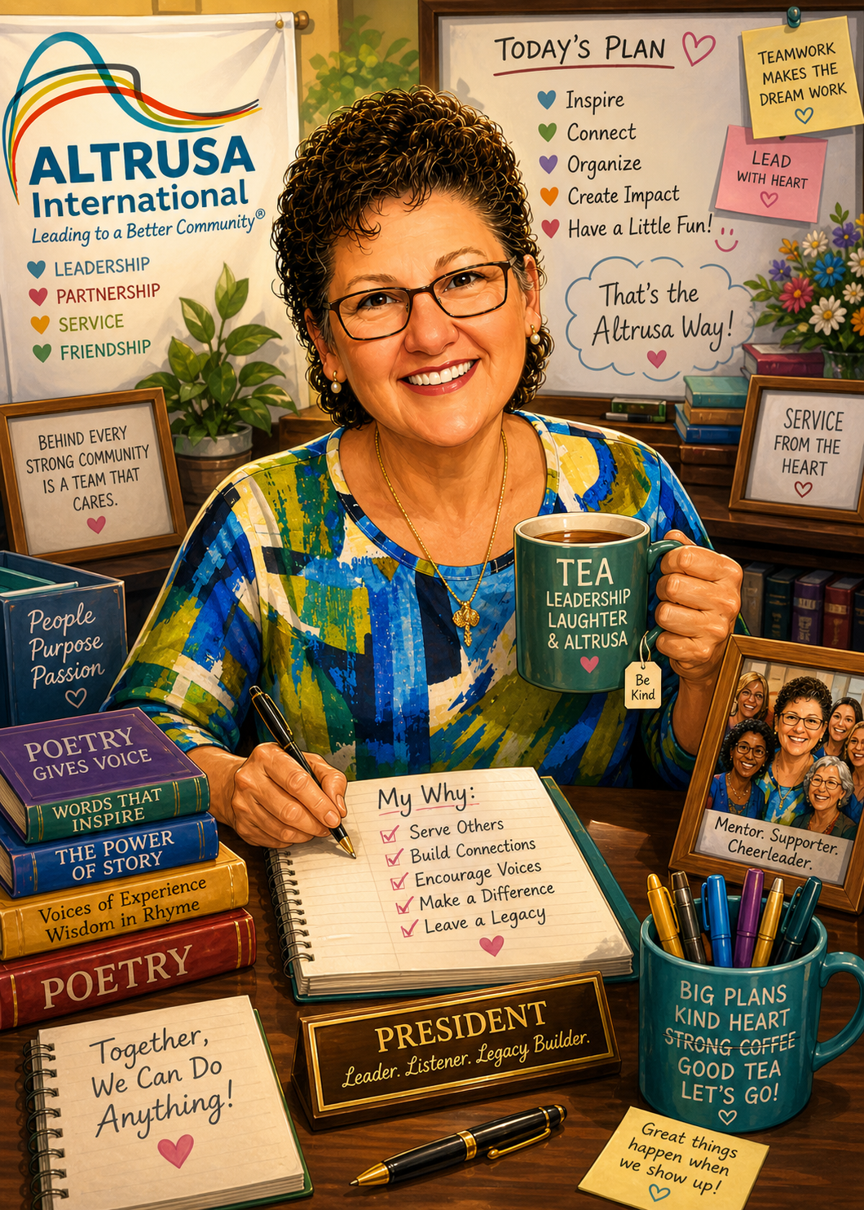
"Create a caricature of me and my job based on everything you know about me.

Slide 20
The POST that WORKED!
20
The Next Time Someone Says…
We should post about this…
You won’t look at your phone…
You won’t avoid eye contact…
You’ll simply say…
I’VE GOT THIS!
Stronger Messaging. Greater Impact. More People Served.
Notes:
Before we wrap up… Let’s imagine the same situation as before…
We’ve just had a great meeting - -good ideas, real impact, a little laughter, and definitely a few things accomplished.
Once again… someone says We should post about this.
But this time… something is different……….. Instead of a long moment of silence, someone says I’ve got it!
They pull out their phone… Type in a quick prompt… Something like…
Write a warm FB post about our Altrusa meeting today, highlight fellowship and community service impact. Make it inviting and upbeat.
They hit enter… And within seconds… There it is.
A post that actually sounds like the energy in the room, the heart behind what we do, and the impact we are making.
But… they don’t stop there…. Because we’ve learned something today.
They tweak it by adding a name, mentioning a project, maybe including a photo… and they make it OURS. They hit POSTl
Later that day, instead of 3 likes… there are COMMENTS, SHARES, and PEOPLE asking HOW CAN I GET INOLVED?
That is the difference.
Not just a better post… but a bigger reach.
Not just better wording… but more impact.
Because everything we do as Altrusans already matters.
AI just helps us make sure people actually SEE it, FEEL it and RESPOND to it.
So… the next time someone says We should post about this…’
You won’t look at your shoes… you won’t be fascinated by your phone… You’ll say I’ve got it!

Slide 21

Your Challenge…
Try one post this week.
Use AI.
Edit it.
Post it.
See what happens.
No pressure…
But we WILL be looking for your posts!
Who’s In?
Notes:
Call to Action…
WHO’S IN?

Slide 22

Linda Ring 860-490-8211
Linda.Ring.Altrusa@gmail.com

