Slide 1

Workshop for Presidents/ Presidents-Elect/
Vice-Presidents
Developed by the 2015-2017 International Leadership Training and Development Committee
Adapted for use in District One
by Pam Lemieux
8/13/2020
Notes:
Please keep the Committee credit if you use this. It was originally developed for District Six in 2007 by Bev Herzog, chair of the this Leadership Committee. It has been updated for District Six through the years, most recently by Governor Chris DeVlieger, who is a member of this committee. All committee members had a hand in updating it to the current form.
Please use the area in yellow to credit the personalization for your district.

Slide 2

Workshop Agenda
District One Information
Incoming President’s Checklist
Club President’s Handbook
Websites and Resources
Meetings
Your issues
Notes:
Obviously, adjust this if you want to add or decrease the agenda due to your time constraints.

Slide 3
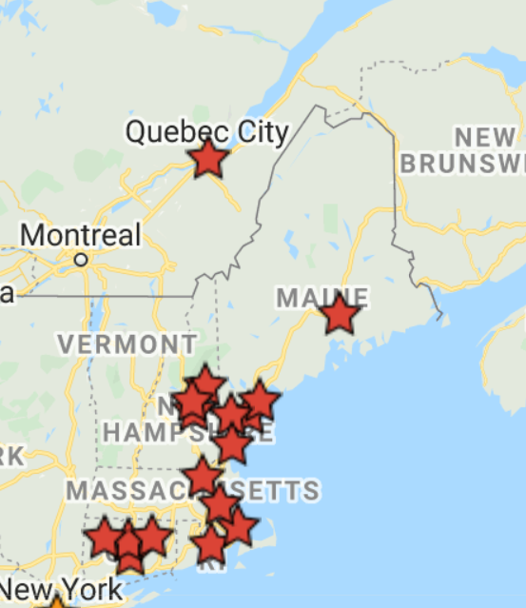
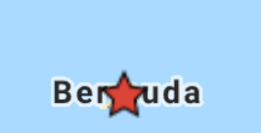
District One Altrusa Clubs
District One
Bangor
Bermuda
Carroll County
Central CT,
Greater Biddeford-Saco Greater Hartford
Laconia
Litchfield County
Meredith
Merrimack Valley
Northeastern CT
Plymouth County
Portland
Quebec
Quincy
Sanford-Springvale
Seacoast
17 Clubs
345 Members
Notes:
Insert a map of your district or a list of clubs. You’d be surprised how many presidents don’t know who’s all in your district. This is a good place to highlight new clubs, where you a trying to build clubs, or clubs you have lost.

Slide 4
District One Officers 2019-2020
Linda Ring Governor
Anne Rash Immediate Past Governor
Pam Lemieux Governor-Elect
Rita Cote 1st Vice Governor
Violet Sims 2nd Vice Governor
Pat Jackowski Secretary
Hilda Schmidt Treasurer
Lucia Shannon Director
Charlene Muscato Director
Ann Marie Snyer Parlimentarian

Slide 5
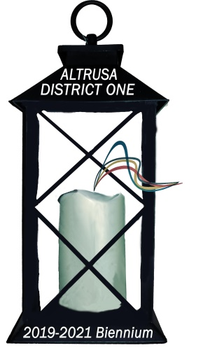
District One
2019-2021 Biennium Theme
Lighting the Way…
for Leaders in Service!

Slide 6

Now that you are President…
What did I get myself into?
  What’s next?
  What do I have to do?
  When?
  How can I get help?

Slide 7
President’s Checklist
March (or sooner)
Pick your installation committee.
Study the Altrusa International Resource Guide, Club Bylaws in the International Bylaws and your club’s specific ones, and other publications.
Select and appoint Committee Chairs except the Nominating Committee.
Meet with the club Strategic Planning Committee to evaluate plan and make necessary changes.
Plan to attend District Conference and encourage members to attend.
Notes:
These checklists are pretty self-explanatory.
Some clubs have their Membership Development Committee do this
Several guides are available on the International website.
The nominating committee is elected. We recommend doing this in the fall so members are paying attention to potential leaders and do less scrambling to fill positions in the spring.
You plan should be reviewed annually.
The District Treasurer will let you know how many delegates you have in early March. You need to send her those names.

Slide 8
Incoming President’s
Checklist - April
Appoint committees early in April.
Conduct club program planning session or retreat. This can also double as the initial meeting of your committees.
Ask Committee Chairs to meet with committee members in late April to set committee goals based on the club’s strategic plan.
Meet with new Committee Chairs to discuss club goals and budget requests for the next year.
Notes:
Let members give you their committee preferences.
This will determine your plans for the coming year.
Each committee should have a budget for what they plan to spend (or raise), which can be combined and negotiated for a club budget. If you have a club foundation, its board will need to let the committee know how much money is available for service projects, as well as having its expenses (filing fees, fundraising costs, etc.)
Items 2 and three can be combined.

Slide 9
Checklist – April continued:
Meet with Finance Committee to begin preparing budget. Give all Committee Chairs a date to have all requests for funds to the Finance Committee.
Share ideas/wishes for installation with your installation committee.
Make sure the Roster of Club Officers and Committee Chairs is reported online to the International Office and to your District Governor/Treasurer.
Attend Presidents’ Workshop at Conference.
Notes:
It is helpful to have the committee chairs on the Finance Committee to negotiate their budget needs.
Please be kind to your committee. There are installation examples on the website.

Slide 10
Incoming President’s
Check List - May
Enjoy your installation ceremony!
Make sure the Club Activity Report is submitted online by the deadline. This determines Distinguished Clubs.
Decide projects for coming year.
Notes:
They need to know if their club expects a speech and what kind of speech—vision or just thank you
This should be done by the outgoing president, but take a look at the kind of information you need to collect
Your service committee should be suggesting these, but the whole club gets a vote.

Slide 11

Most Important
Paperwork to Submit
Roster of club officers and committee chairs
  after installation of officers (permissions will change immediately on the International website)
  by current or out-going President or Treasurer
Club visit request form
  will get from club visitor
Award nominations
List of conference delegates
Club Activity Report
Notes:
These are all pretty obvious

Slide 12
Important District & International Form
Report Officers and Committee Chairs to International, if not already done by your current president or treasurer. Go to International website, login, then go to Membership, and access Group Tally to update the Club Officers and Committee Chair Roster.
Send this information to your District Governor or Treasurer, whichever they request.
Notes:
OK, we’re really harping on this because it’s really important and some clubs don’t do it or need many reminders. It drives governors and treasurers nuts to not have this contact information. The Group Tally is where treasurers pay dues, update club membership, add new members and update club officers and committee chair. The Club President and Treasurer have access to Group Tally (if current input is correct). In the event of not being able to access Group Tally, they need to contact Altrusa International.
EVERYONE uses this! International to mail notices and publications.
Governor to mail updates.
Committee chairs to contact your club committees.
etc.

Slide 13
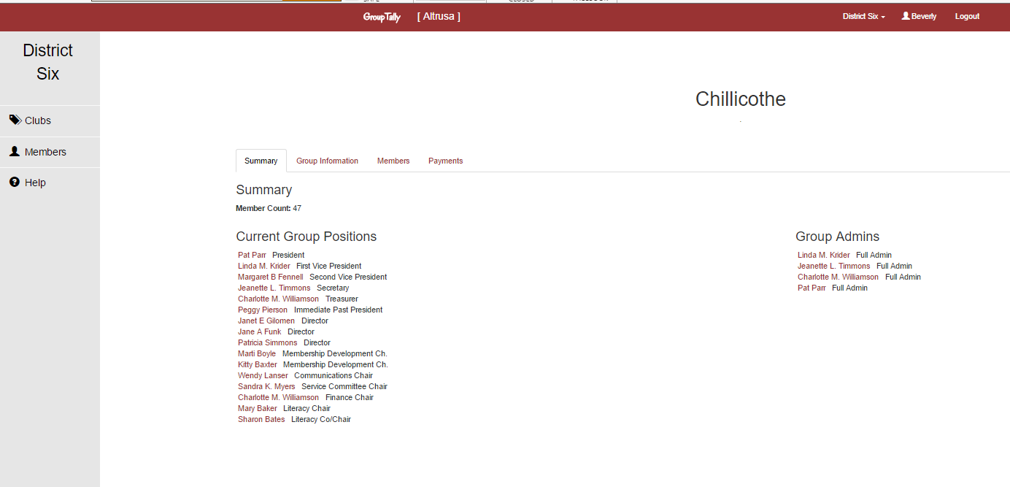
Club Roster
Notes:
Those with permission (the current president and treasurer) will see an edit button under “Summary”. This is where you submit your officer and chair information for International

Slide 14
Where can I get some Help
Altrusa websites
Publications from International Office
A phone call, email, or IM to your Immediate Past President
A phone call, email, or IM to a District Board Member
Your Club President’s Handbook newly revised on www.altrusa.org
Notes:
Note that some districts assign a board member to each club. This is who you should contact. This might be your assigned district visitor.

Slide 15
International Websites
  International
  www.altrusa.org
    Single login will give you access to all secure materials, except club rosters in Group Tally
    ID = altrusan
    Password = MamieLethaNina1917
District One
  www.districtone.altrusa.org
Notes:
Add your district information to this page

Slide 16
International Website
MAIN page = About Altrusa in General
Members Only Section:
Membership
Service
Communications
Leadership
Governance
Events
Alternate sites include:
Group Tally
Foundation
ASTRA
Altrusa Store
International Service Project Database

Slide 17

Review the Club President’s Handbook
Available on Altrusa International website
Member Login
Publications
Manuals
Club President’s Handbook – Revised January 2020
Or under Leadership Development, there are multiple resource materials

Slide 18
The Club President’s Handbook - Content
The President--Introduction
Leadership
Planning and Evaluating
Presiding
Working with the Board of Directors
Club Finances
Revised
January 2020

Slide 19
More from the Handbook
6. Membership Development
ASTRA
Altrusa in the Public Eye
Communications
Files and Reports
Awards
The Altrusa International Foundation
~only 53 pages

Slide 20

Leadership Tasks
Visioning
Identifying priorities
Initiating agenda-setting and establishing direction and overall strategy
Modeling
Securing environmental changes and opportunities for communicating
Lobbying for support
Source: Management or Leadership: Which is Which? By Philip Tinega
Notes:
Many of these could be their own workshop. The International website has workshops on visioning, succession planning, and more with even more planned for the future. Please feel free to use (and modify them) for use in your district or club.

Slide 21

Leadership Tasks (cont.)
Recruiting people for key positions
Aligning people direction and coalition building
Motivating, inspiring, and connecting members
Creatively exploring options
Actively seeking/negotiating resources
Succession planning
Source: Management or Leadership: Which is Which? By Philip Tinega

Slide 22

Agenda Planning
Develop your agenda around this format:
  Minutes from previous meeting
  Treasurer’s Report
  Correspondence
  Actions of the Executive Committee
  Committee Reports
  Unfinished Business
  New Business

Slide 23

Agenda Planning
Be as specific as possible
  Include actions (votes, sign-ups)
Consider including time allotted for each item
Distribute BEFORE the meeting
  Preferably 24 hrs. before the meeting
Notes:
A good agenda gives members a reason to attend your meeting. Show them what they will miss if they are gone.
at least 24 hours before the meeting?
Why? Those who work may not have time during their day to download, print and/or review items for discussion. Need to give EVERYONE time to prepare.

Slide 24
#1 Problem: Losing Focus
Discussion off agenda item or point of meeting
Excessive digressions
Lack of participation by some, domination by others
Bickering, disrespectful behavior
No conclusions or decisions
Side conversations
Source: Human Resources Growth Partners, 2001
Notes:
This is (or was) the main reason people hate meetings. The next slide tells you how to fix it.

Slide 25
Getting Back on Track
Remind purpose of meeting/ agenda item
Clarify question on table; summarize discussion
Recognize contributions
Control disruptive behavior
Table items, if no decision can be made
Source: Human Resources Growth Partners, 2001
Notes:
Most clubs don’t normally use formal motions or Roberts Rules of Order, and that’s fine if it works for you. You can pull them in occasionally when a contentious issue needs calming.

Slide 26
Problem #2: Lack of Participation
Keep meeting focused
Encourage quiet members, control excessive talkers
Make suggestions, allow silence and listen carefully
Pay attention to physical setting
Reinforce participation
Chart group response
Source: Human Resources Growth Partners, 2001
Notes:
The dot points are all about increasing participation

Slide 27
Concluding the Meeting
Review progress and decisions
Review assignments, due dates, and checkpoints
Develop items for next agenda
Thank participants
Source: Human Resources Growth Partners, 2001

Slide 28
Tips from Others…
Copyright laws
Balancing the club’s legacy and change
Select Committee Chairs ASAP
Offer Officer & Committee Chair training
Use materials from Altrusa
Create and customize a strategic plan with your Board & Committee Chairs
Agendas & Parking lots
Notes:
If it is difficult to get people to take on leadership roles, share information about the roles and expectations with them. Explain to potential members up front.

Slide 29
Contact Information:
Linda Ring, District One Governor Linda.Ring.Altrusa@gmail.com
Pam Lemieux, District One Governor- Elect Pamela.Lemieux@myfairpoint.net
Elsie Mathews, District One Leadership Chair Elsie.altrusacentralct@gmail.com

Slide 30


