Slide 1
President’s Workshop
Altrusa International District Eleven
May 2020

Slide 2
You have been elected President of your Club!
from

Slide 3
Pat Zoller
Governor
April Smith
2nd Vice Governor
Hillary Sloan
Secretary
Melinda Aguirre
Governor Elect
Andrea Shallcross
Director
Leslie Johnson
Treasurer
Bonnie McPherson
1st Vice Governor
Pat Young
Parliamentarian
Melanie Hodges
Immediate Past Governor

Slide 4
Governor’s Theme Biennium: 2019 - 2020
Believe
Begin
Become

Slide 5
Yes, you have been elected President
of your Club!
This can be a little scary, as well as, exciting and
personally fulfilling!

Slide 6
Now what?

Slide 7
As the club’s top officer, the president holds the club’s most challenging position. At the same time, the office of club president offers the most reward as it is the office most able to move the club forward. With the help of the board and individual committee members, the president can help the membership attain exciting new service project achievements as well as gain greater community recognition for the club. Also it is a position that develops leadership skills that can be further developed at the District and International levels.

Slide 8
The key to success as the presiding officer is maintaining the appearance of impartiality. Members may know you have an agenda for the organization. In fact, you were probably elected because you have some vision and ability. However, while presiding over the meeting, leave it to your members to do all the debating; step back and let things take care of themselves.
Some of the best presiding officers have been some of the most opinionated. But they knew how to lead by participating in working committees and helping their program by selling members on it, not forcing it on them. Giving equal time to the minority when debating contested issues gives these leaders the respect of all members.

Slide 9
The President
who helps the Club arrive at its true deliberative will
is the winner!

Slide 10
Successful Leaders
Successful leaders have been shown to exhibit six actions:
They promote a vision. Followers need a clear idea of where you’re leading them, and they need to understand why the goal is valuable to them. Your role as a leader is to provide that vision.
They make others feel important. If your goals and decisions are self-centered, followers will lose their enthusiasm quickly. Emphasize their strengths and contributions, not your own.

Slide 11
They follow the Golden Rule. Treat your followers the way you enjoy being treated.
They admit mistakes. If people suspect you are covering up your own errors, they’ll hide their mistakes, too, and you’ll lack valuable information for making decisions.
They give credit and praise in public and criticize others only in private. Public praise encourages others to excel.
Stay close to the action. Be visible to members of your organization. Talk to people, observe other organizations, ask questions, and observe how other groups do business. Often you will gain new insights into your work and find new opportunities for motivating your members.

Slide 12
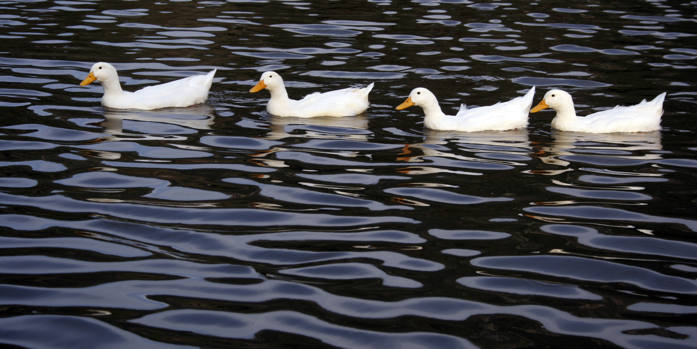
Survive by getting your “ducks in a row”!

Slide 13
#1 Be Organized
Plan. “Failing to plan is planning to fail”
Outline your plan. Write out your plan.
Delegate.
Monitor.

Slide 14
#2 Be Informed
Use the Altrusa International Website
Use the Altrusa International District Eleven Website
Read the Club President’s Handbook

Slide 15
#3 Communicate Refer to 6 Reasons Why Effective Communication Is Important To Your Club on District Eleven Website
Check email regularly.
Communicate with Altrusa International and District Eleven when requested or when you have questions.
Communicate new information to your Club.

Slide 16
Random Thoughts
God before Country – The Altrusa Grace or Collect is said first followed by the Pledge of Allegiance.
During the meeting, the minutes and financial report are presented and do not need a motion to be accepted.
After the minutes has been presented and corrected if needed, the President says, “The minutes are approved ‘as presented’ or ‘as corrected’”.
After the treasurer’s report has been presented and questions addressed, the President says, “The treasurer’s report will be “placed on file’ or ‘filed for audit’”.
Develop your strategic plan early in your year because it can be used to measure your progress. Use the International and District Strategic Plans as a Guide (of course found on the respective Websites).

Slide 17
Plan to have Club projects that can be submitted for District and International Awards.
Apply for Grants from the International Foundation to support your projects.
There are benefits to having a mentor or mentors. This gives the President a ‘go to’ person who will listen and give answers or advice if it is wanted.
Turn in Roster of Officers and Chairs (Found on District Eleven Website) to Governor and 1st Vice Governor.
Life is all about how you handle Plan B? Plan A is always our first choice. You know, the one where everything works. But more often than not somethings don’t go as they should. This is the point where the real test of character comes in. Do you wallow in disappointment or simply shift gears and make the best of the situation. After all…life is all about how you handle Plan B! (Life Is All About How You Handle Plan B by Suzy Toronto) Remember, Altrusans are flexible!

Slide 18
Submit Officers and Chairs to International and District Eleven
Form available on District Eleven Website.
www.altrusadistricteleven.org

Slide 19
Many Resources are Available
Club President’s Handbook – Available on the Altrusa International Website in the Member Section under Leadership.
Point of Order - Available on the Altrusa International Website in the Member Section under Leadership.

Slide 20
President’s Monthly Guidlines – Available on the District Eleven Website.
Also, your District Eleven Board is available to help you. Our contact information is on the District Eleven Website.
Most Importantly…

Slide 21
Have Fun!!!

Slide 22
Websites
District Eleven
www.altrusadistricteleven.org
Altrusa International
www.altrusa.org

